Slide 1
Process Improvement In Batch
Put-up Using Six Sigma

Slide 2
WHO ARE INVOLVED IN THIS PROJECT?
Six Sigma Advisor:
    Dr. Erick C. Jones (Assistant Professor)
Project Team Members:
    Laderian A. (Visiting Instructor)
    Pushparaj S. (Graduate Student)
    Valiveti R. (Graduate Student)
Project Sponsors:
    Terry Branting
    Greg Chapman

Slide 3
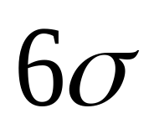


Total Quality Management 996A
How we got involved to do a project
The project is a portion of the work assignment in this course.
What is project?
This is a statistical term that is used to introduce a certain type of approach to the
real world problems.
is actually the distance between mean of the population and the specification
limit.
What is ?
Sigma, , is the standard deviation of the population.

Slide 4
Another way to distinguish if we have a process is to observe 3.4 defects or less per million opportunity in the process

Slide 5
HOW DOES A COMPNAY BENEFIT FROM A SIX SIGMA PROJECT?

Slide 6
A six sigma approach
DMAIC is a structured method of six sigma:
Define
Measure
Analyze
Improve
Control

Slide 7
Medium Level Process Map
Receive
Material
Batch Put up
Mixer
Sheeting
Make
Product
Ship
Product
Blends
Raw
Resin
Batch Put-up Chemicals

Slide 8
Detailed level Process Map
Receive
Material
Check specification
sheet
Load Material in carousel
Weigh Material
Load material in blender
Blend the materials
Mixer
Bag Count
Label

Slide 9
Define
The main objective of this process is to prepare as many number of bags as possible according to the schedule. This is done by front line employees.
There are three 8-hour working shifts per day.
In every shift there are 2 employees working and every individual works separately.
The content of bags are different ingredients.

Slide 10
Define (contd…)
There are more than 200 different specs of ingredients and as a result at different times the employees have different types of bags to put up.
The ingredients must be weighted to certain limits which is specified on the spec sheet.
Every spec sheet shows how many different bags are involved and how many ingredients are in every bag.
An employee should put up as many bags as he can during an 8-hour shift from several spec sheets.

Slide 11
Project Charter
Project Name | Process Improvement in the Batch put-up using six sigma
Green Belt Candidates | Ali Laderian, Srinivasa Pushparaj, Rama Valiveti
Sponsor | Terry Branting
Finance Representatives | Terry Branting and Greg Chapman
Estimated Savings | $ 138,000 / year
Problem Statement | A large variation in average operator output from batch put-up of chemicals used in compounds mixed in proprietary mix process.
Project metrics | Primary metric: Average number of bags per operator per shift Secondary metric: Loss of productivity due to mixer downtime (in dollars)
Goal statement | Reducing the variation in the number of bags prepared by individual operators in the batch put-up production.
Project scope and scale | The whole batch put-up, testing department and blending section , administrators, operators and 200 different chemical compounds
Team Members | Ali Laderian Srinivasa Pushparaj Rama Valivetti

Slide 12
Measure
The metrics are defined as
    Primary Metrics: Average number of bags per hour per operator.
    Secondary Metrics: Loss of productivity due to mixer downtime (in dollar value).
After brainstorming sessions cause and effect diagram was constructed for the primary metric.

Slide 13
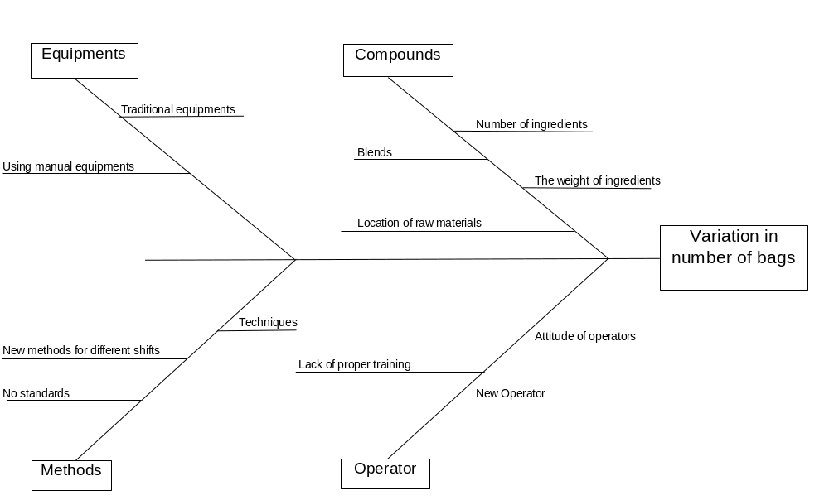
Measure (contd…)
Cause and Effect Diagram

Slide 14
Measure (contd…)
From the cause and effect diagram the root cause is identified as the operators and the compounds.
Data was collected primarily from
    Archival sources
    Interviews with qualified personnel
    Observation of operators at work

Slide 15
Quality Function Deployment
 | Quality Function Deployment | KPOVs | Variations in number of bags | Mixer downtime | Ratings | Rank
 |  | CPR # | 10 | 9
 | KPIVs
1. | Operators |  | 10 | 9 | 181 | 1*
2. | Number of ingredients |  | 8 | 7 | 143 | 3*
3. | Shifts |  | 10 | 5 | 145 | 2*
4. | Blends |  | 9 | 5 | 135 | 4
5. | Arrangement of workplace |  | 5 | 3 | 77 | 7
6. | Testing department |  | 0 | 7 | 63 | 8
7. | Accuracy in scaling |  | 6 | 5 | 105 | 6
8. | Pyramid weighing |  | 5 | 8 | 122 | 5

Slide 16
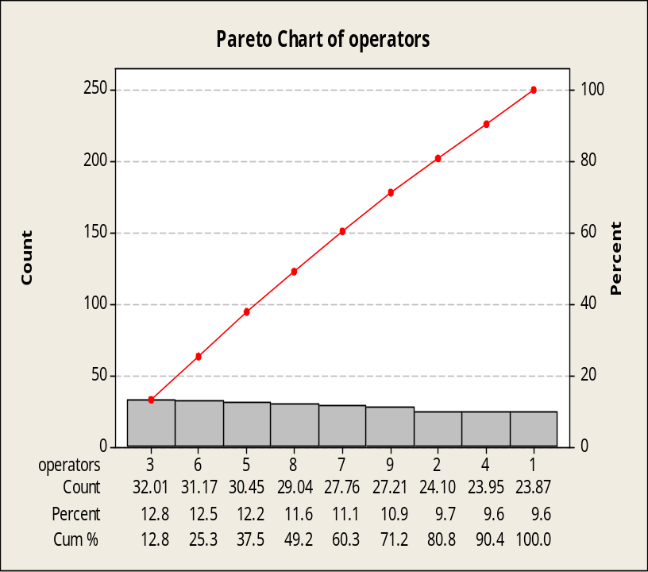
Measure (contd…)
From the data collected, Pareto chart was plotted in Minitab to prioritize the operators based on the numbers of bags per shift.

Slide 17
Analysis
One way Analysis of variance (ANOVA) was performed using SAS to see if the difference between the means of each level is significantly more than the variation within each level.
The model designed for ANOVA is
Average number of bags/hour = Operator + Shift + Ingredients/Bag + Blends

Slide 18
Analysis (contd…)
The ANOVA Procedure
Dependent Variable: Bags/Hour
Sum of
Source DF Squares Mean Square F Value Pr > F
Model 126 12220.17398 96.98551 1.85 0.0013
Error 86 4517.18412 52.52540
Corrected Total 212 16737.35810
R-Square Coeff Var Root MSE Bags/Hour Mean
0.730114 26.46666 7.247441 27.38329
Source DF Anova SS Mean Square F Value Pr > F
Operator 8 2117.503162 264.687895 5.04 <.0001
Shift 2 1403.838147 701.919074 13.36 <.0001
Ingredients/Bag 109 8171.357876 74.966586 1.43 0.0432
Blends 7 527.474797 75.353542 1.43 0.2020
Decent Model
Insignificant factor

Slide 19
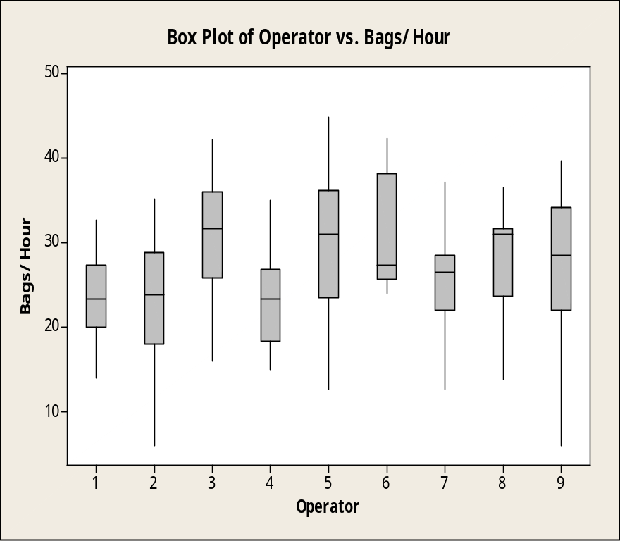
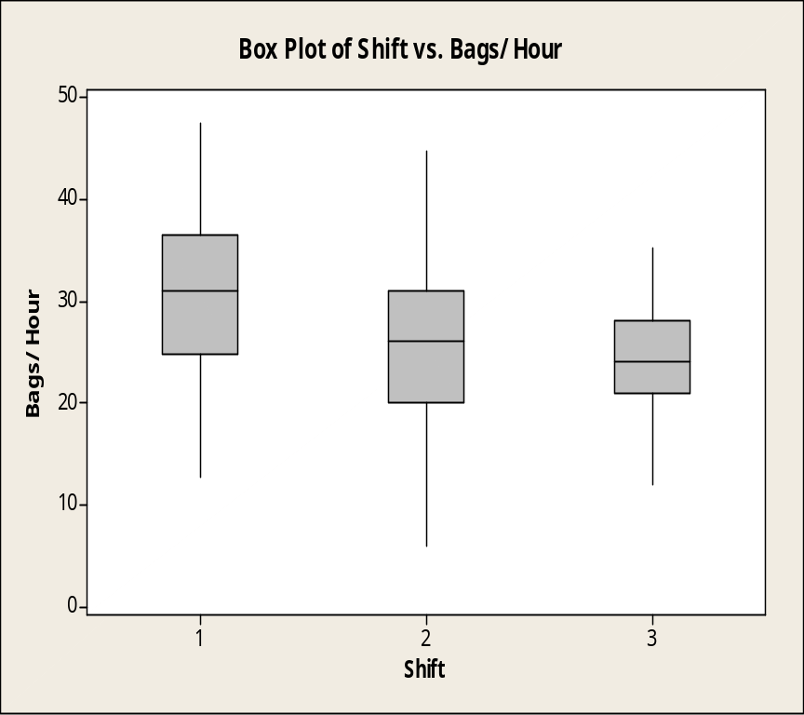
Analysis (contd…)
To confirms the results of ANOVA, box plot was plotted for Operator vs.
Bags/hour and Shift vs. Bags/hour.

Slide 20
Analysis (contd…)
p-value of ingredients/bag is very close to the 0.05 significance level
To further study ingredients/bag, blends were neutralized with the bags/hour using the formula:
25’ approx.
(Average time taken for preparing a Blend)
Blend Equivalent to Bags (BEB) =
(Average time for producing a Bag)
15.43 Bags per Blend
1.62’ per Bag

Slide 21
Analysis (contd…)
The ANOVA Procedure
Dependent Variable: New Bags/Hour
Sum of
Source DF Squares Mean Square F Value Pr > F
Model 119 16013.29469 134.56550 3.00 <.0001
Error 93 4167.39487 44.81070
Corrected Total 212 20180.68956
R-Square Coeff Var Root MSE Bags/Hour Mean
0.793496 22.72934 6.694079 29.45127
Source DF Anova SS Mean Square F Value Pr > F
Operator 8 3286.49211 410.81151 9.17 <.0001
Shift 2 2389.74645 1194.87322 26.66 <.0001
Ingredients/Bag 109 10337.05613 94.83538 2.12 0.0001
Decent Model

Slide 22
Analysis (contd…)
Interaction effects were checked between the operators and ingredients/bag using the model
Average number of bags per shift = Operator + Shift +
Operator*Ingredients/Bag

Slide 23
Analysis (contd…)
The ANOVA Procedure
Dependent Variable: Bags/Hour
Sum of
Source DF Squares Mean Square F Value Pr > F
Model 187 16508.37549 88.28008 9.64 <.0001
Error 25 228.98261 9.15930
Corrected Total 212 16737.35810
R-Square Coeff Var Root MSE Bags/Hour Mean
0.986319 11.05212 3.026434 27.38329
Source DF Anova SS Mean Square F Value Pr > F
Operator 8 2117.50316 264.68790 28.90 <.0001
Shift 2 1403.83815 701.91907 76.63 <.0001 Operator*Ingredients/Bag 177 12987.03418 73.37307 8.01 <.0001
Very good Model
Interaction is significant

Slide 24
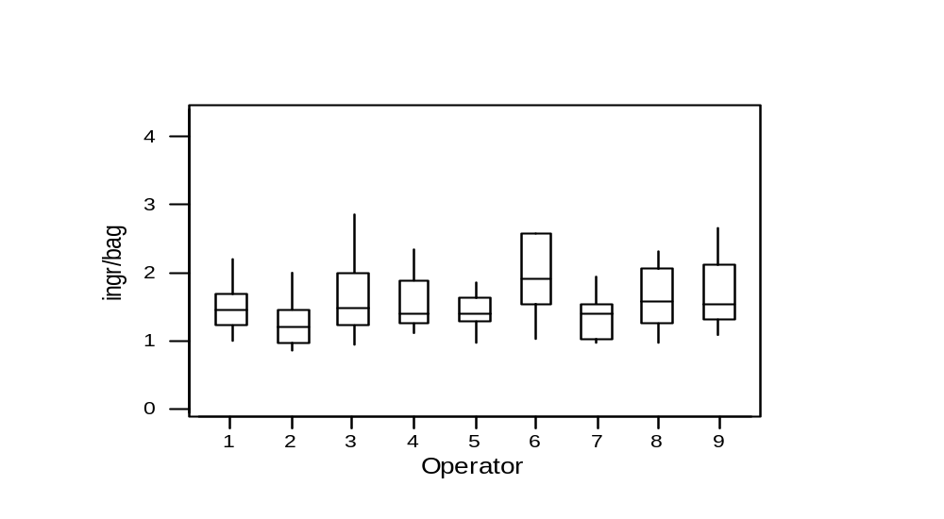
Analysis (contd…)
Box plot shows that there is significant interaction between Operators and number of Ingredients per Bag

Slide 25
Analysis (contd…)
Results:
  The significant factors affecting the primary metric are
    Operators
    Shift
    Number of Ingredients per bag
The interaction effects for the operators and shift was plotted in Minitab using Multi-vari charts.

Slide 26
Analysis (contd…)
Multi-Vari Charts
Multi-Vari chart is a tool that graphically displays patterns of variation. It is used to identify different types of variations such as lot-to-lot, shift-to-shift, machine-to-machine etc.
Assumption: If an operator did not work for a particular shift then the average value of the number of bags per hour for the same shift is used as data for analysis.

Slide 27
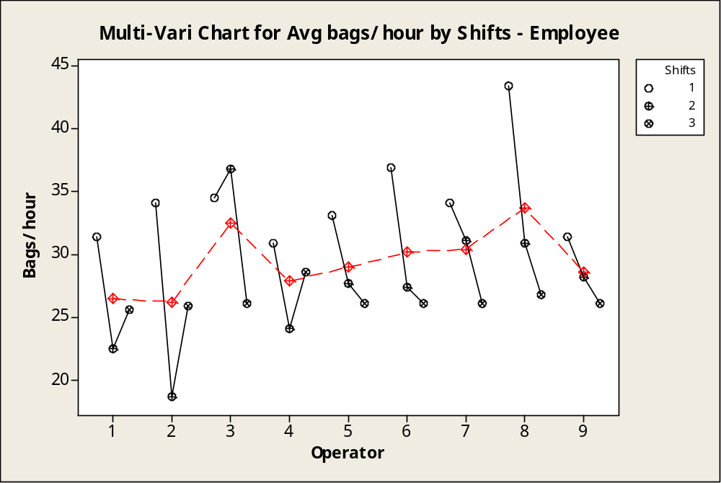
Analysis (contd…)

Slide 28
Analysis (contd…)
Observations
Operators 8 and 3 are most productive. Operators 1 and 2 are least productive.
There is a large variation in the output of the average number of bags per hour among the operators. (operator-to-operator variation)
There is a large variation in the output of the average number of bags per hour of each operator for different shifts. (shift-to-shift variation)

Slide 29
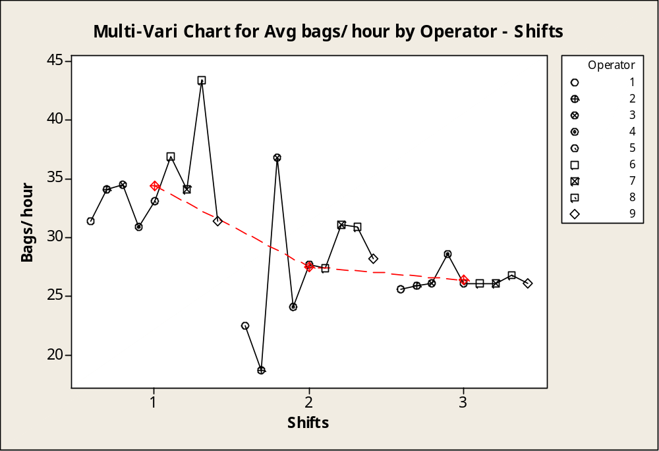
Analysis (contd…)

Slide 30
Analysis (contd…)
Observations:
Productivity is decreasing from shift 1 to shift 3.
The variation among different operators in shift 1 and shift 2 is higher than the variation in shift 3.
More than 50% of the workers in shift 1 are making at least 35 bags per hour which is the average for shift 1.

Slide 31
Improve
From the Analysis it is clear that there is a shift-to-shift and operator-to-operator variation in the process.
The interviews with the process owner showed that the nature of work remains the same in all the three shifts. Further investigation led to the conclusion that a supervisor is present in shift 1 and the absence of a supervisor is the cause of poor productivity in shift 2 and shift 3.
Operator-to-operator variation shows that there is a difference in either the technique applied or productive utilization of the time by different operators.
It has also been shown that more than 50% (5 out of 9) of the operators in shift 1 made at least 35 bags per hour.

Slide 32
Improve (contd…)
Recommended Steps to Improve the process:
Supervision should be implemented for all the 3 shifts. This will reduce the shift-to-shift variation.
The operators should be videotaped at work and ergonomic analysis should be done for the best techniques to be applied. Then the operators should be trained accordingly. This is a very important part of Quick Changeover (QCO) process. This will reduce the operator-to-operator variation.
The least average number of bags per hour an operator should make must be
set as 35. This will improve the productivity of the process (all the 3 shifts) as a whole.
5S techniques should be revised in the work area to set a better target for continuous improvement.

Slide 33
Improve (contd…)
Saving Analysis
Assumptions:
Two operators work for each shift.
Batch-put up process is active for 6-days a week.
Data Used:
Average time taken to make a bag.
Amount company spends per operator per minute.
Average number of bags per each shift.
Savings:
Least savings in improving the average number of bags in all the shifts to the new set 35 bags per hour are $138772/year

Slide 34
Prediction of Control Plan
Establishing several control charts concerning number of bags per shift
    Having control charts for every operator for all shifts.
    Having control charts for operators working on different shifts.
    Having control chart for all operators working in batch put up process on any shift.

Slide 35
Prediction of Control Plan
X bar and R charts seem adequate to control the batch put up process

Slide 36
Alternative Control Plan
Establishing Control Charts for number of ingredients per shift
    Every operator on all shifts.
    For all operators on different shifts.
    For all operators working in batch put up process.

